Slide 1


Constituency Connect
Group Members:
Muhammad Ahsan 21-ARID-737
Haseeb Ur Rehman 21-ARID-715
Huzaifa Bin Shahzad 21-ARID-719
Supervised By:
Ms. Farkhanda Qamar
UNIVERSITY INSTITUTE OF INFORMATION TECHNOLOGY

Slide 2
Table of Contents
Brief overview
Project Features
Stakeholders
Functional Requirements
Use-Case Diagram
Non-Functional Requirements
Traceability
Block Diagram
Concept Diagram
System Sequence Diagram

Slide 3
1.Brief Overview
Bridges communication gaps between constituents and representatives.
Empowers citizens to voice concerns effectively and transparently.
Key features include:
Complaint Reporting with real-time updates.
Virtual Meetups for direct interaction.
Performance Tracking to monitor issue resolution.
Automated Notifications to keep users informed.
Promotes civic engagement and strengthens accountability.

Slide 4
2.Project Features:
Key Features
Complaint Reporting System
Report complaints, view history, and track status.
Route complaints to representatives or department handlers.
Prioritize urgent complaints for immediate action.
Survey and Polling System
Participate in surveys; create and analyze results.
Real-time survey results with visualizations for trends.
Data Analytics and Statistics
Displays complaint resolutions and survey statistics.

Slide 5
2.Project Features:
Key Features
Virtual Meetups
Schedule discussions with constituents.
Integrate with platforms like Zoom/WebRTC for video calls.
Feedback System
Gather public sentiment on representative performance.
Role-Specific Dashboards
Customized dashboards for Constituents, Representatives, and Handlers.
Event Calendar
Anonymous Reporting

Slide 6
3.StakeHolders
Primary Stakeholders
Constituents
Representatives
Department Complaint Handlers
Secondary Stakeholders
Video Conferencing Service Providers
System Administrators
Developers and Technical Teams

Slide 7
4.Functional Requirements
Users (Constituents and Representatives):
Register on the platform and log in with valid credentials.
Constituents:
Report complaints and track their status.
Access complaint history and performance statistics of representatives.
Participate in surveys and attend virtual meetups.
Provide feedback on complaint resolutions and representative performance.
Representatives:
Register using official email addresses.
Update complaint statuses and forward issues to relevant departments.
Schedule virtual meetings and distribute custom surveys.

Slide 8
4.Functional Requirements
Department Complaint Handlers:
Update the status of assigned complaints.
Reroute mis-categorized complaints to representatives.
Miscellaneous:
Notify constituents about complaint updates and upcoming meetings.
Display survey results using charts and graphs.
Highlight sensitive complaints for urgent action.

Slide 9
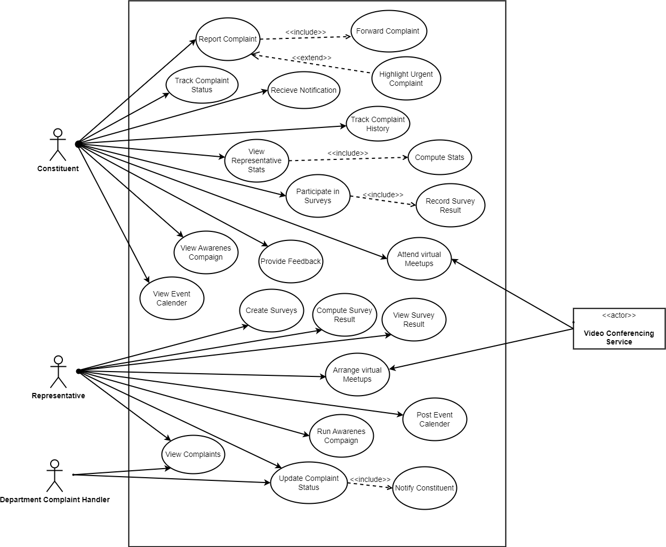
5.Use-Case Diagram

Slide 10
6.Non-Functional Requirements
The system must load each page within 2 seconds for 95% of user interactions.
The engineers should scale the system to support up to 10,000 concurrent users.
The system must ensure 99.9% uptime availability, allowing no more than 8 hours of downtime annually.
The system must provide complaint submission confirmation within 2 seconds.
The system should support browser compatibility for the latest two versions of Chrome, Firefox, Edge, and Safari.
The system must handle complaint routing with a response time of under 2 seconds per action.
User sessions should time out after 30 minutes of inactivity for enhanced security.

Slide 11
7.Traceability
Requirement Names:
R1: Allow users to register on the platform.
R2: Allow users to log in with valid credentials.
R3: Constituents can report a complaint.
R4: Constituents can track the status of their complaints.
R5: Constituents can access complaint history.
R6: Constituents can view representative performance statistics.
R7: Constituents can participate in surveys and polls.
R8: Constituents can attend virtual meetups.

Slide 12
7.Traceability
Requirement Names:
R9: Constituents can provide feedback on complaints and representatives.
R10: Representatives register using official email addresses.
R11: Representatives can create and distribute custom surveys.
R12: Representatives can schedule and host virtual meetings.
R13: Representatives can update complaint statuses.
R14: Representatives can forward complaints to departments.
R15: Representatives can post event calendars.
R16: Representatives can run awareness campaigns.

Slide 13
7.Traceability
Requirement Names:
R17: System routes categorized complaints to departments automatically.
R18: System routes uncategorized complaints to representatives.
R19: System notifies constituents about complaint updates and meetings.
R20: System records survey responses.
R21: System displays survey results visually.
R22: System prioritizes complaints with sensitive keywords.
R23: Department Complaint Handler updates complaint statuses.
R24: Department Complaint Handler reroutes miscategorized complaints

Slide 14
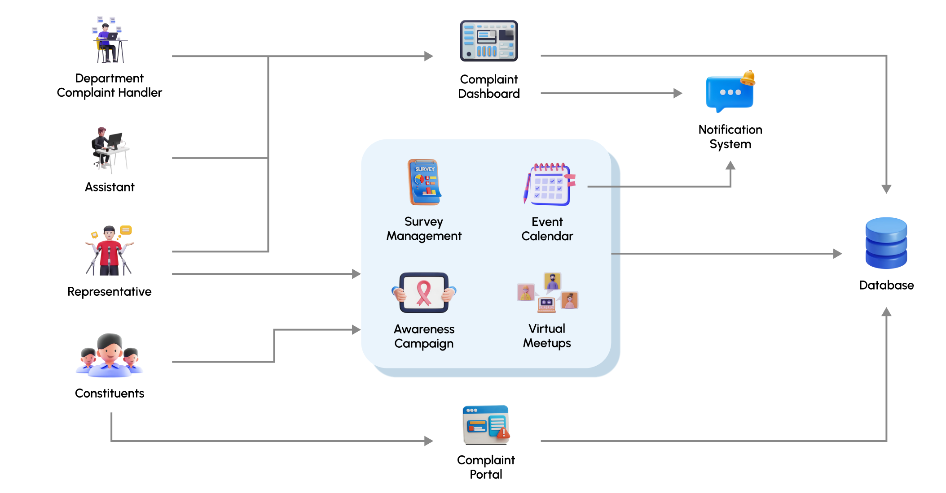
8.Block Diagram

Slide 15
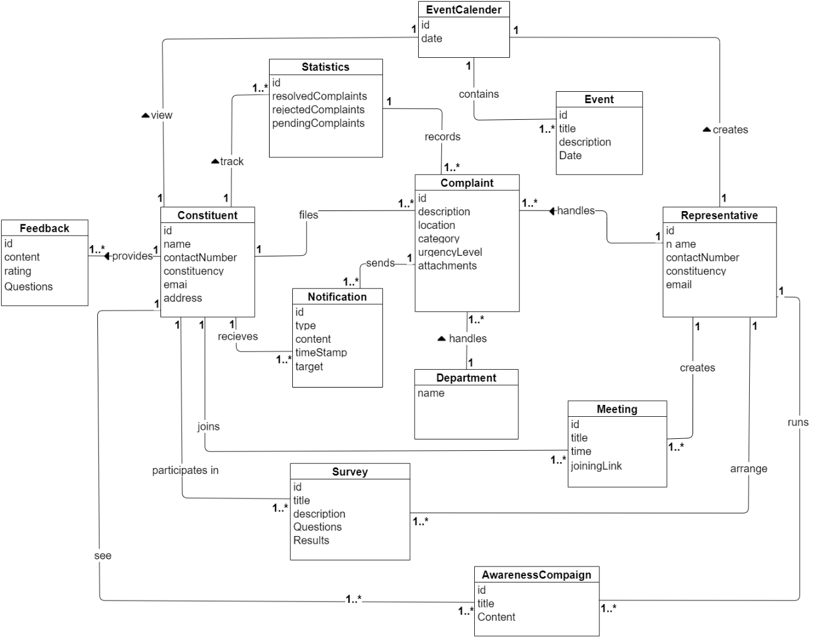
9.Concept Diagram

Slide 16
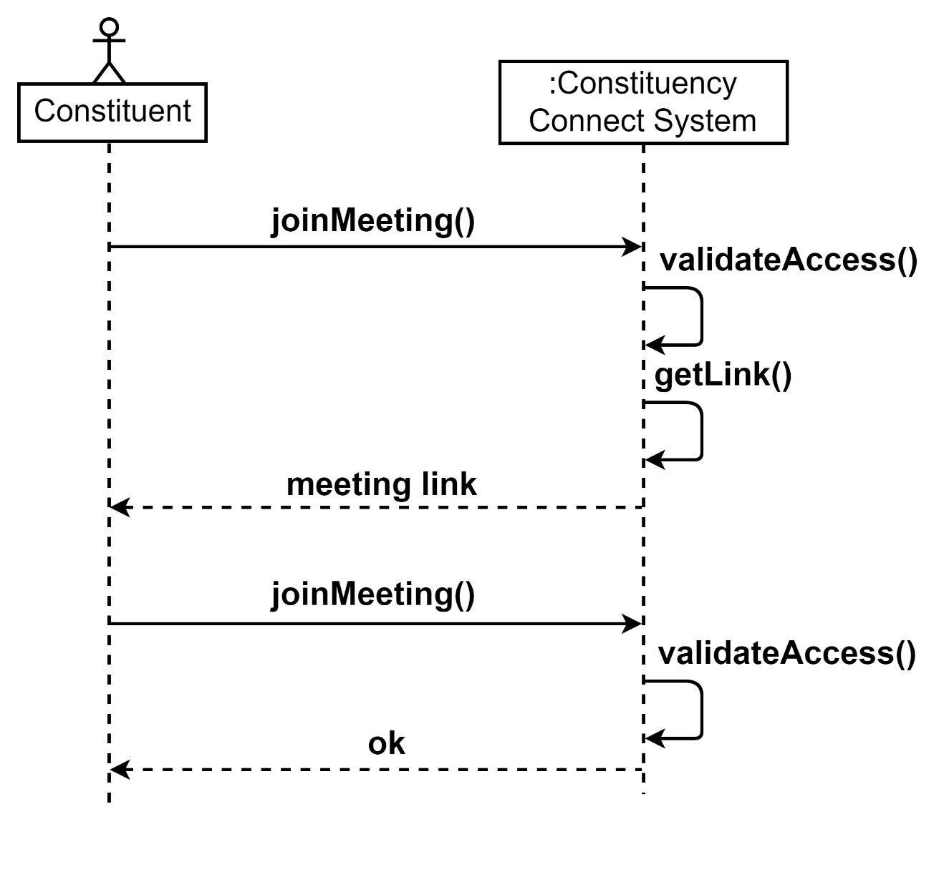
10.System Sequence Diagram

Slide 17
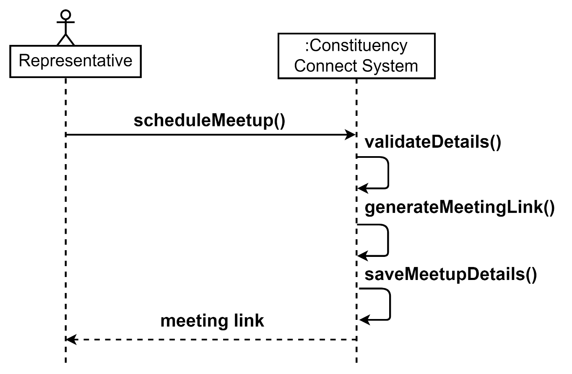
10.System Sequence Diagram

Slide 18
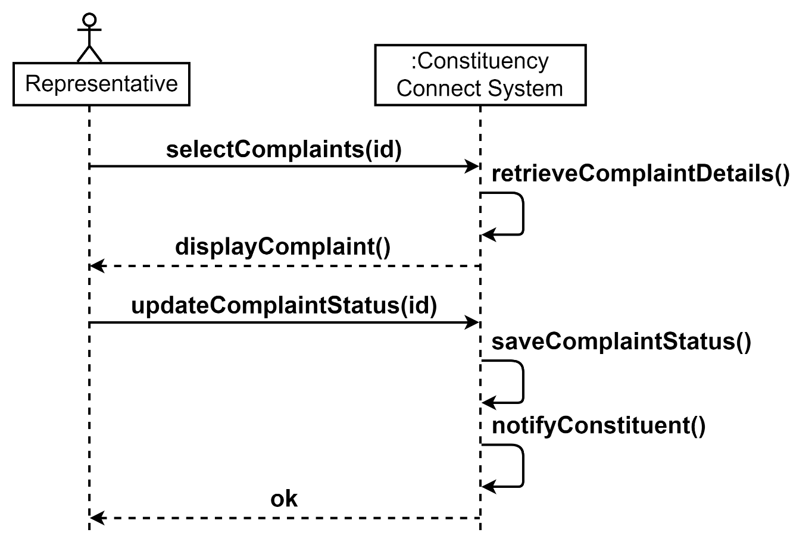
10.System Sequence Diagram

Slide 19
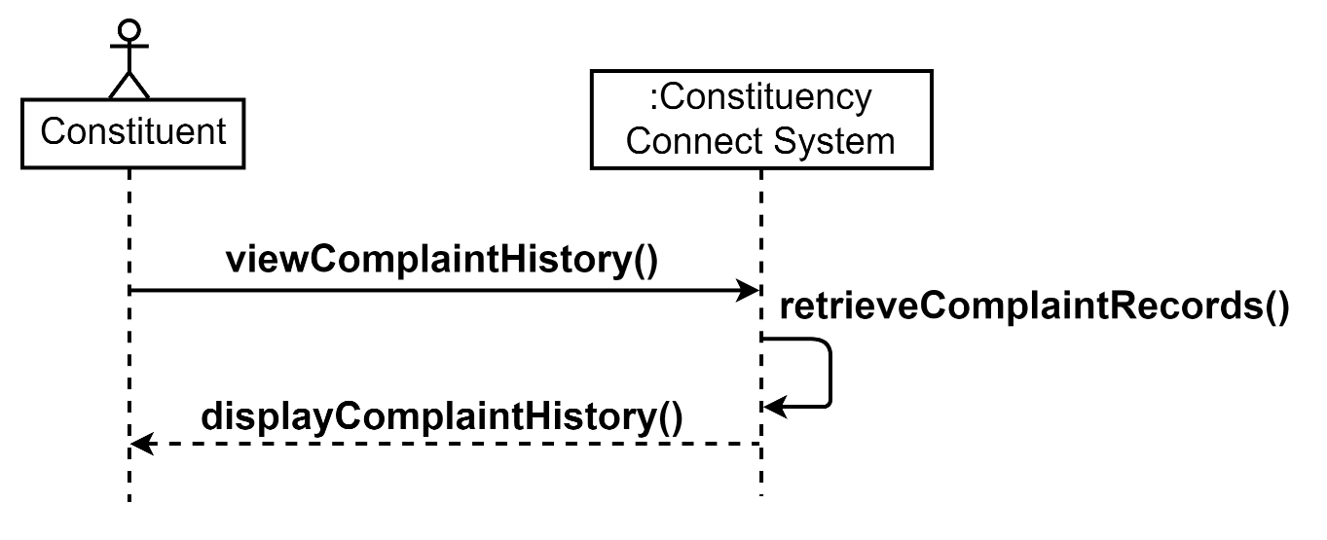
10.System Sequence Diagram

